Slide 1
ListView/ GridView / RecyclerView
Android Applications Development

Slide 2
ListView
In Android, a ListView is a view group that displays a list of scrollable items. It is a commonly used UI component in Android app development for showing a list of data items, such as contacts, emails, or photos.
To use a ListView in your Android app, you typically follow these steps:
Add a ListView to your app's layout XML file, either by dragging it from the palette in Android Studio or by manually adding it to the layout XML code.
Create an adapter that provides the data to the ListView. The adapter is responsible for creating a view for each item in the list and binding data to the views. There are different types of adapters available in Android, such as ArrayAdapter, CursorAdapter, and BaseAdapter.
Set the adapter for the ListView using the setAdapter() method. This tells the ListView to use the adapter to populate its content.
Optionally, you can add event listeners to the ListView to handle user interactions, such as tapping on an item in the list.

Slide 3
ListView
Here is a simple example of using a ListView in an Android app:
// In your activity's onCreate() method
ListView listView = findViewById(R.id.list_view);
String[] items = {"Item 1", "Item 2", "Item 3"};
ArrayAdapter<String> adapter = new ArrayAdapter<>(this, android.R.layout.simple_list_item_1, items);
listView.setAdapter(adapter);
In this example, we create a ListView with the ID list_view in the layout XML file. We then create an array of string items and an ArrayAdapter to provide the data to the ListView. Finally, we set the adapter for the ListView using setAdapter().

Slide 4
GridView
In android, GridView is a view group that display items in two dimensional scrolling grid (rows and columns), the grid items are not necessarily predetermined but they are automatically inserted to the layout using a ListAdapter. Users can then select any grid item by clicking on it. GridView is default scrollable so we don’t need to use ScrollView or anything else with GridView.
GridView is widely used in android applications. An example of GridView is your default Gallery, where you have number of images displayed using grid.
Adapter Is Used To Fill Data In Gridview: To fill the data in a GridView we simply use adapter and grid items are automatically inserted to a GridView using an Adapter which pulls the content from a source such as an arraylist, array or database.

Slide 5
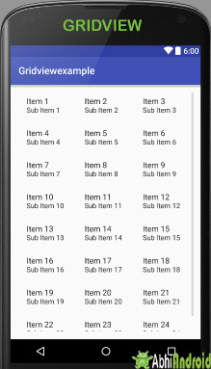
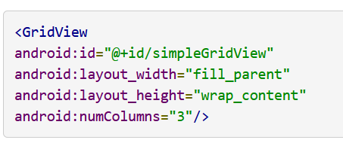
GridView
GridView in Android Studio: Gridview is present inside Legacy. From there you can drag and drop on virtual mobile screen to create it. Alternatively you can also XML code to create it.
Basic GridView code in XML:
Important Note: numColumns property has to be specified otherwise GridView behaves like a ListView with just singleChoice. In the above image numColumns property specified that there is 3 columns to show, if we set it to auto_fit then it automatically display as many column as possible to fill the available space of the screen. Even if the phone is in portrait mode or landscape mode it automatically fill the whole space.

Slide 6
Attributes of GridView
id: id is used to uniquely identify a GridView.
numColumns: numColumn define how many columns to show. It may be a integer value, such as “5” or auto_fit. auto_fit is used to display as many columns as possible to fill the available space on the screen.
horizontalSpacing: horizontalSpacing property is used to define the default horizontal spacing between columns. This could be in pixel(px),density pixel(dp) or scale independent pixel(sp).
verticalSpacing: verticalSpacing property used to define the default vertical spacing between rows. This should be in px, dp or sp.
columnWidth: columnWidth property specifies the fixed width of each column. This could be in px, dp or sp.

Slide 7
Adapter in GridView
An adapter actually bridges between UI components and the data source that fill data into UI Component. Adapter can be used to supply the data to like spinner, list view, grid view etc.
The ListView and GridView are subclasses of AdapterView and they can be populated by binding them to an Adapter, which retrieves data from an external source and creates a View that represents each data entry.
GridView and ListView both are subclasses of AdapterView and it can be populated by binding to an Adapter, which retrieves the data from an external source and creates a View that represents each data entry. In android commonly used adapters which fill data in GridView are:
1. Array Adapter
2. Base Adapter
3. Custom Array Adapter

Slide 8
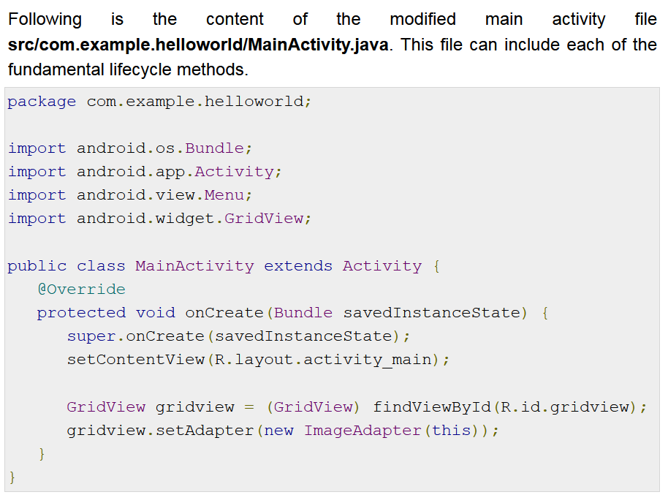
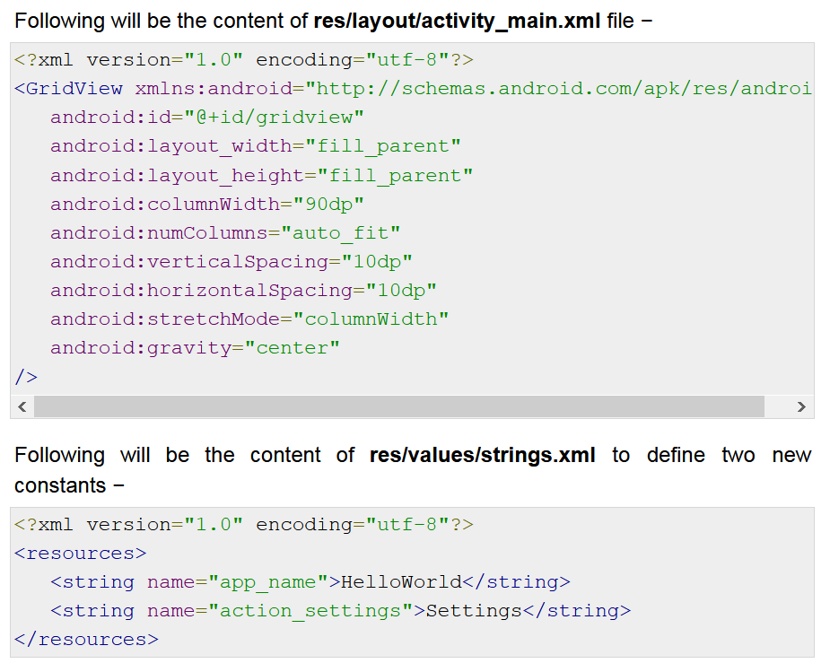
GridView Example using Array Adapter

Slide 9
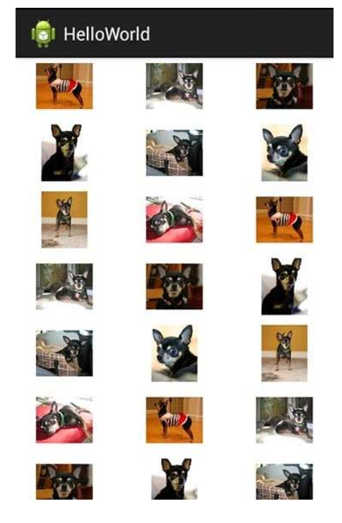
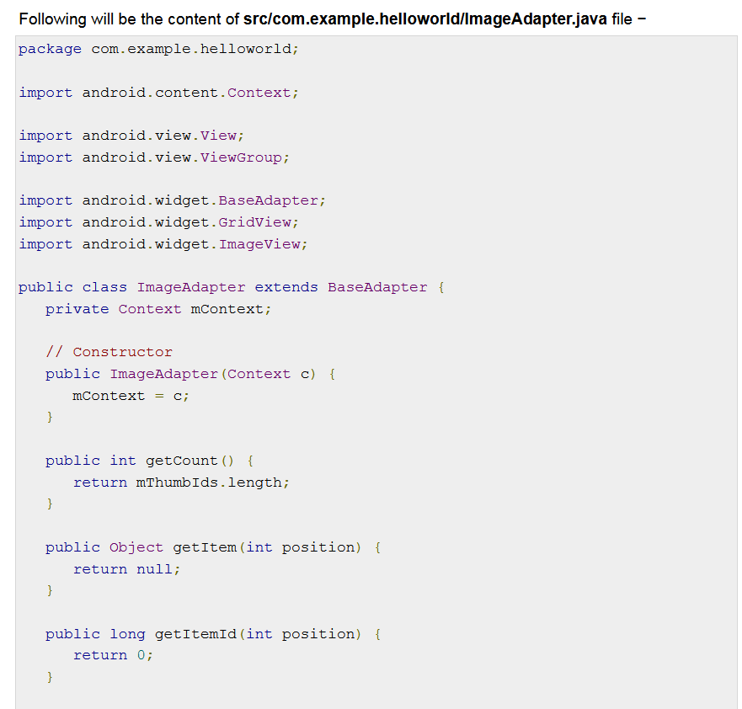
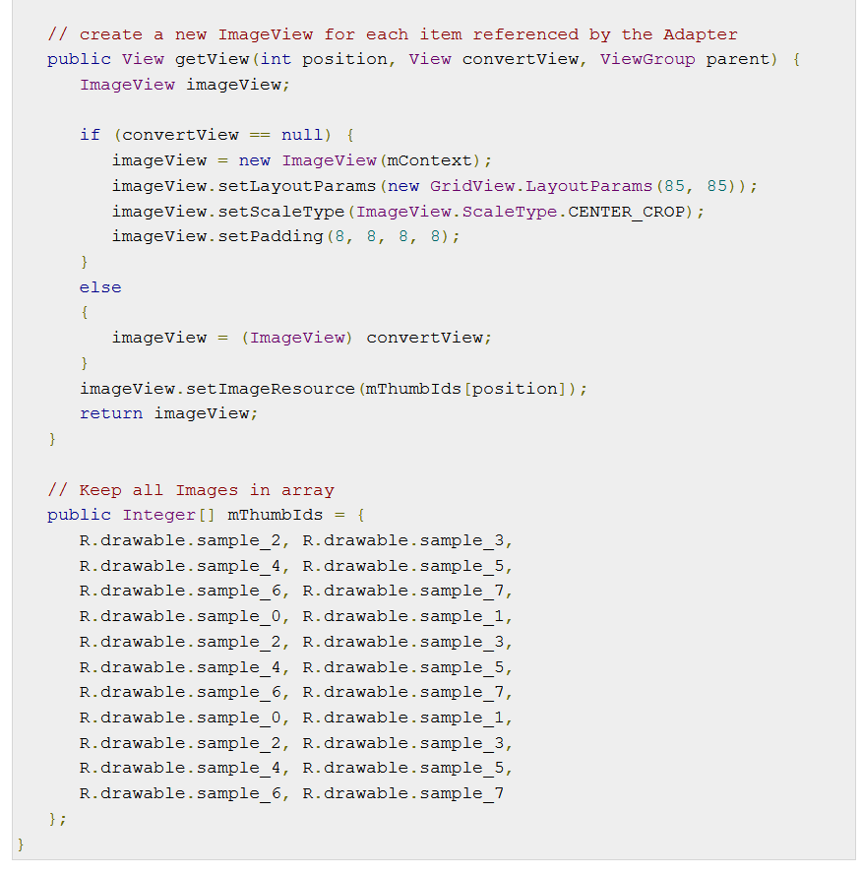
GridView Example using Array Adapter

Slide 10
What is RecyclerView ?
View Group to display large set of data.
For each item in large dataset, it display a view.
Efficient way to implement Scrollable list.

Slide 11
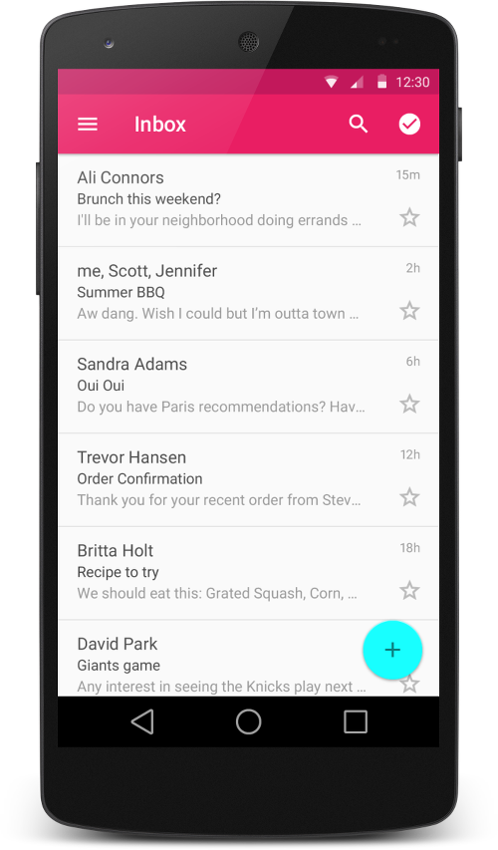
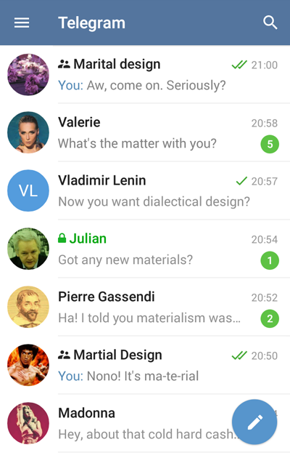
What is RecyclerView ?

Slide 12
What is RecyclerView?
DATA = [“item1”,”item2”,.....”item1000”]
For each item, we have a view. But if we create a view for each item in ONE GO then we have 1000 views but user can only see 10-15 (depends) views at a time. Memory wastage.

Slide 13
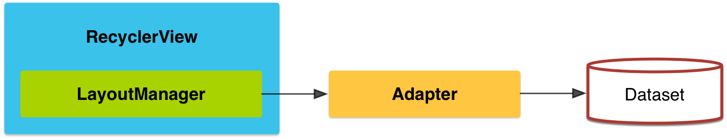
RecyclerView Concept
View Holder :
This will hold the view and helps in recycling.
Adapter :
This will adapt our data so that it can be displayed in a list.

Slide 14
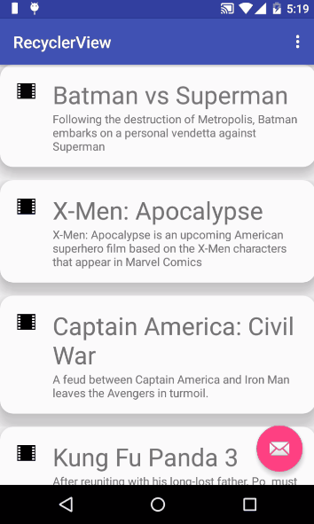
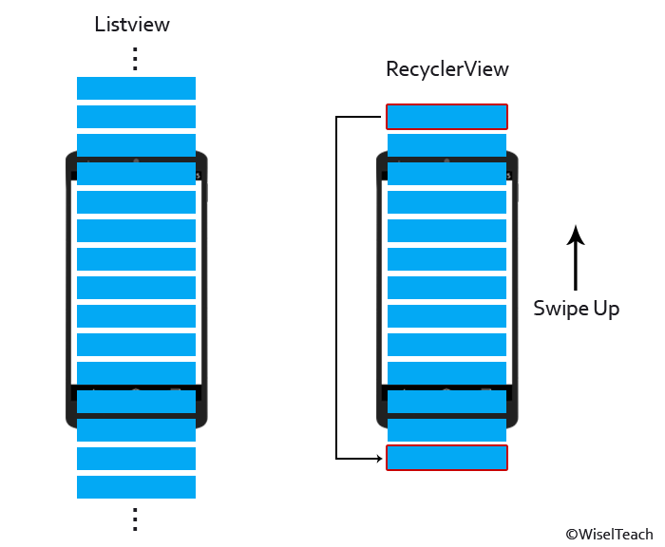
Working of RecyclerView

Slide 15
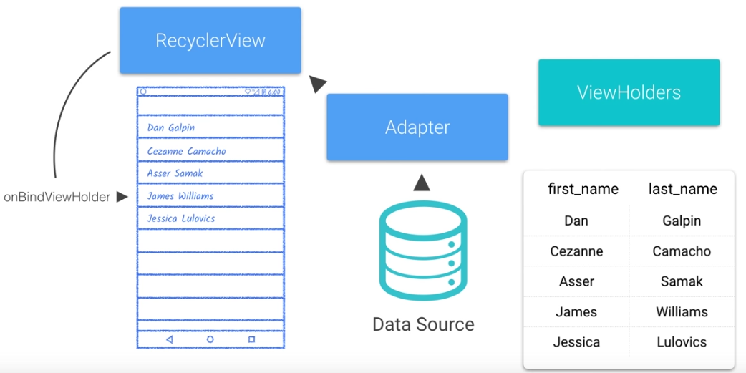
Working of RecyclerView

Slide 16
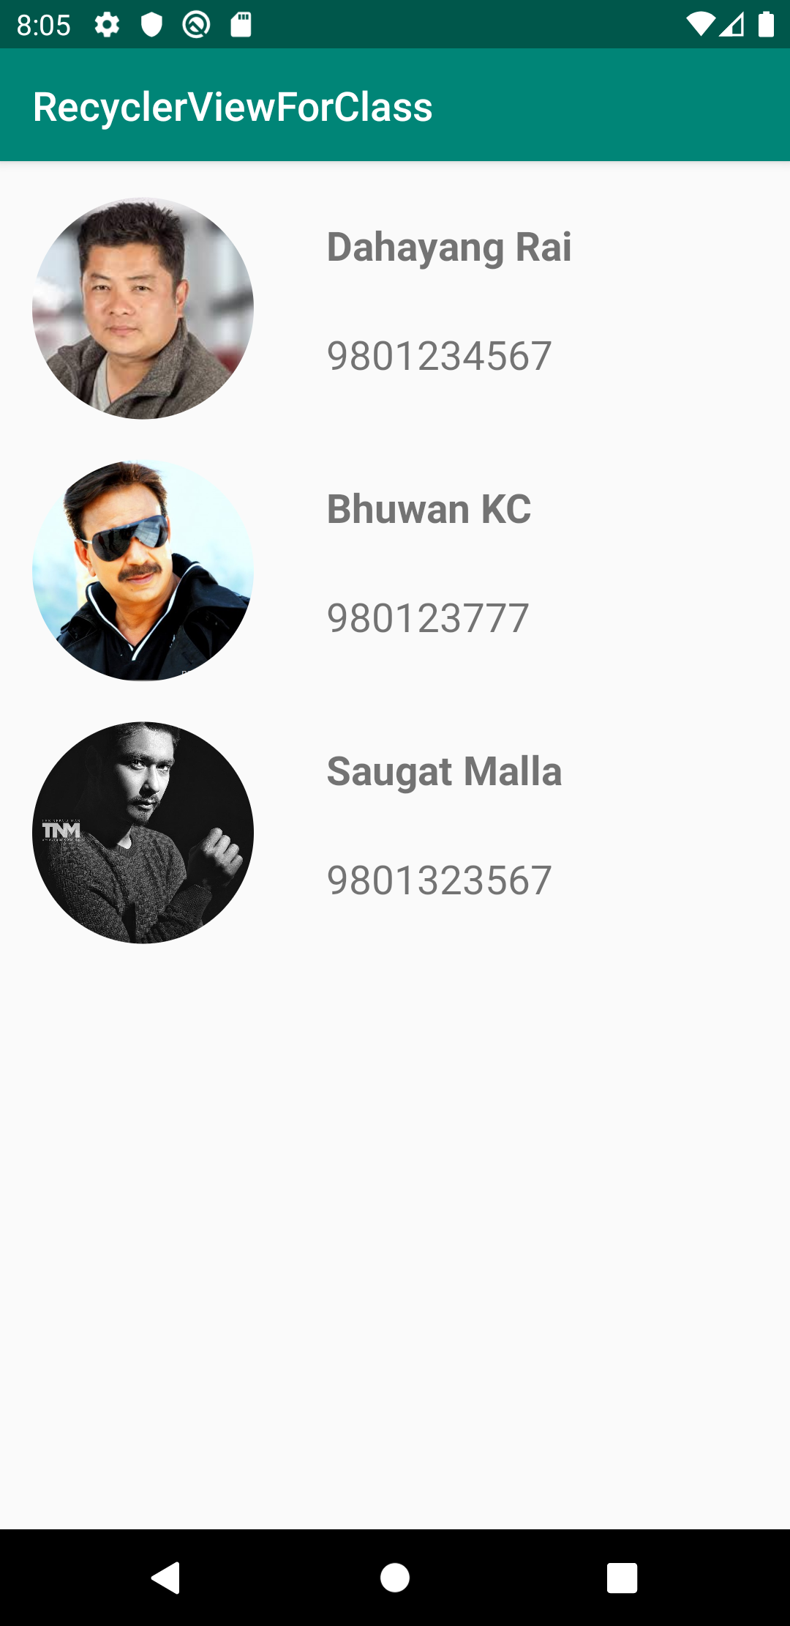
RecyclerView App

Slide 17
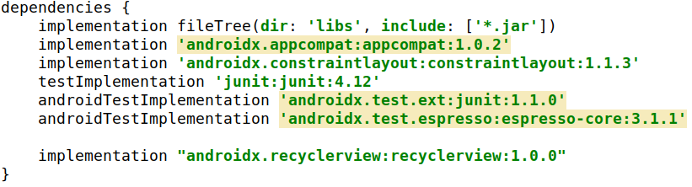
1. Add library for recyclerview in build.gradle
Copy and paste in build.gradle file
implementation "androidx.recyclerview:recyclerview:1.0.0"

Slide 18
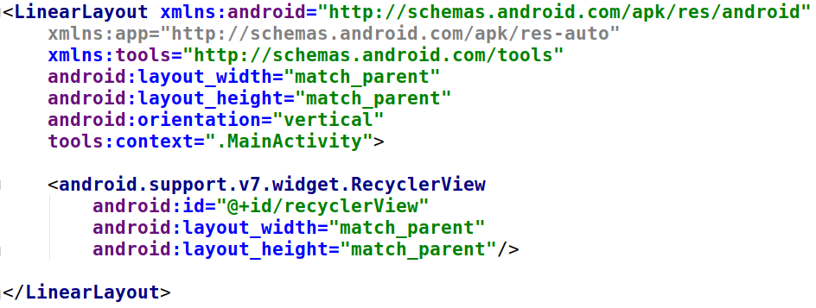
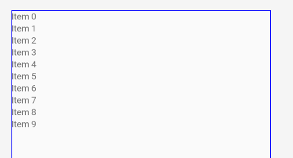
2. Add RecyclerView in XML

Slide 19
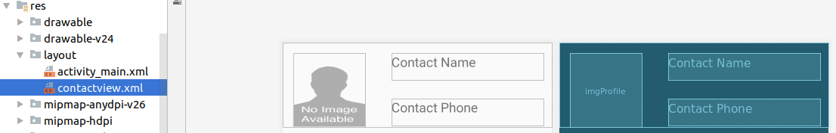
3. Add another layout file
go to res->layout-> right click and click new and create a layout resource file.
For now give a name as contact using constraint layout ( or any other layout)

Slide 20
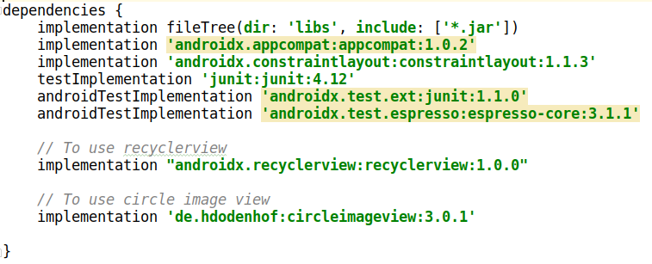
3. Using circular image view
implementation 'de.hdodenhof:circleimageview:3.0.1'

Slide 21
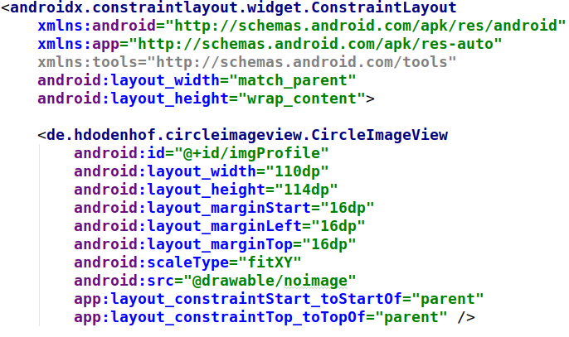
3. Using circular image view

Slide 22
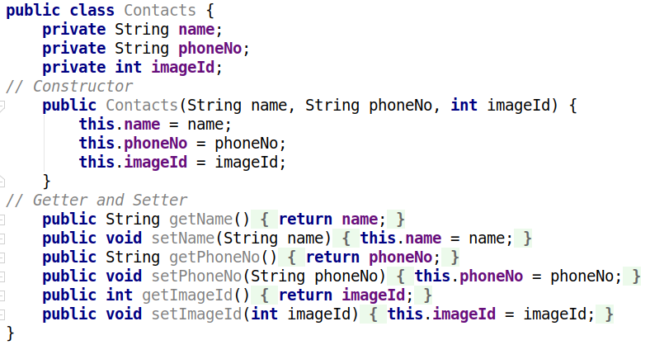
4. Create a model class
create a class named Contacts.java.

Slide 23
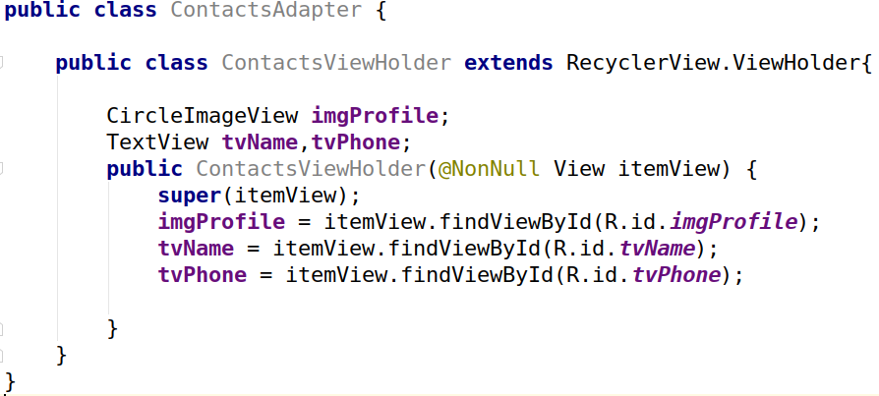
5. Create an Adapter for Contact class and add ViewHolder class
Inner Class

Slide 24
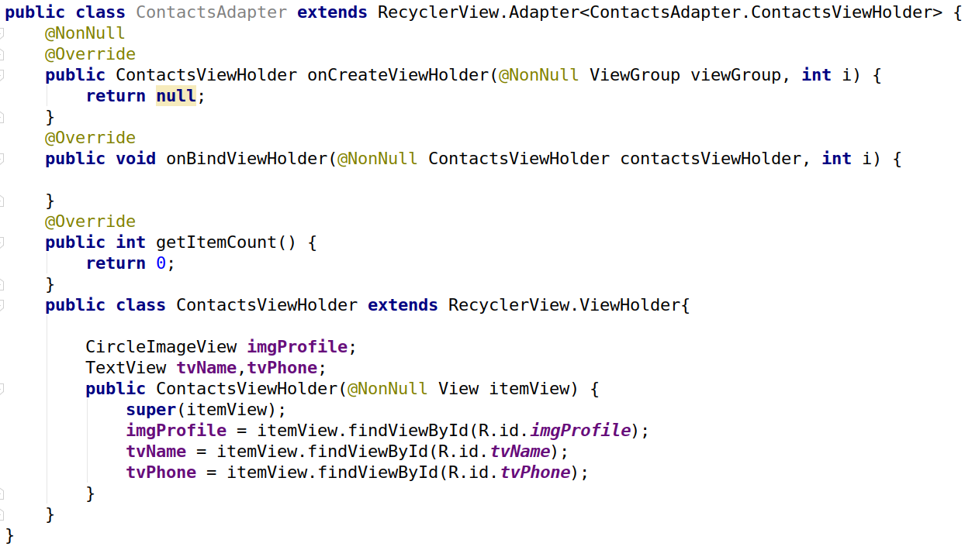
6. Extend the ViewHolder class in Adapter class

Slide 25
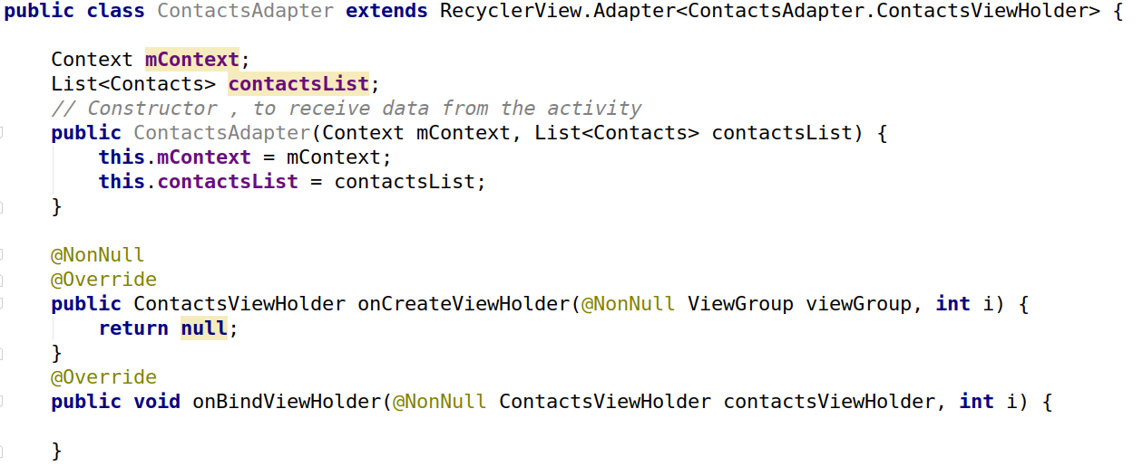
7. Create a constructor of adapter class

Slide 26
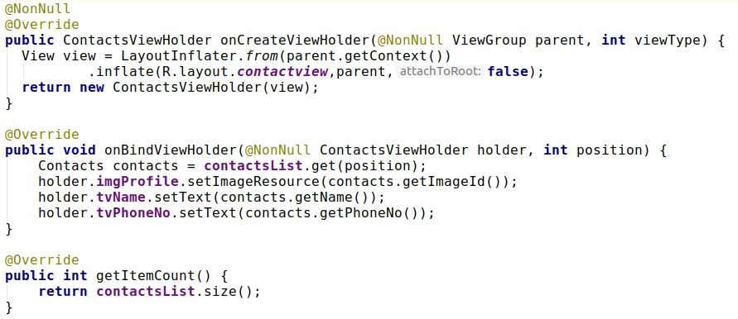
8. Override 3 methods of ViewHolder

Slide 27
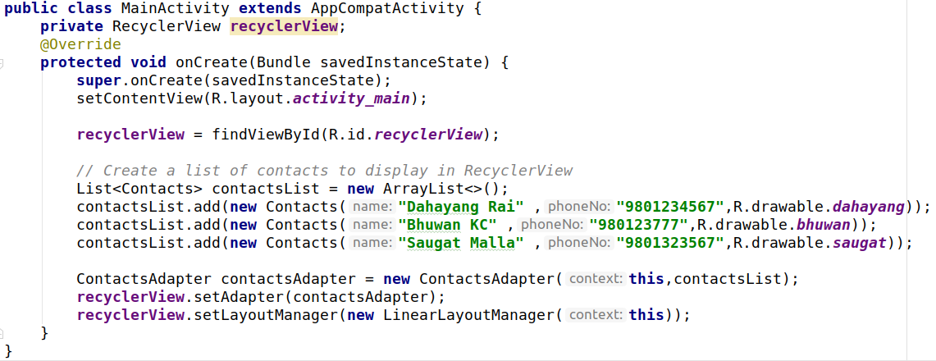
9. MainActivity

Slide 28
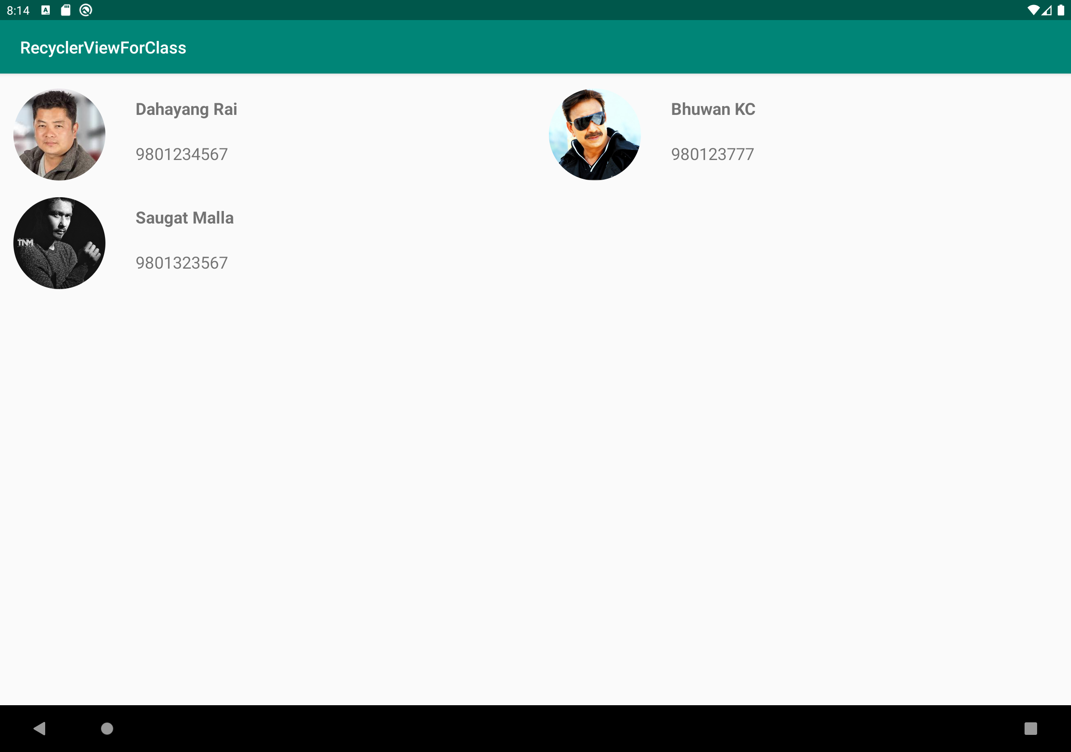
Displaying Contacts in gridLayout
Reduce the margin
and
textsize of Textview

Slide 29
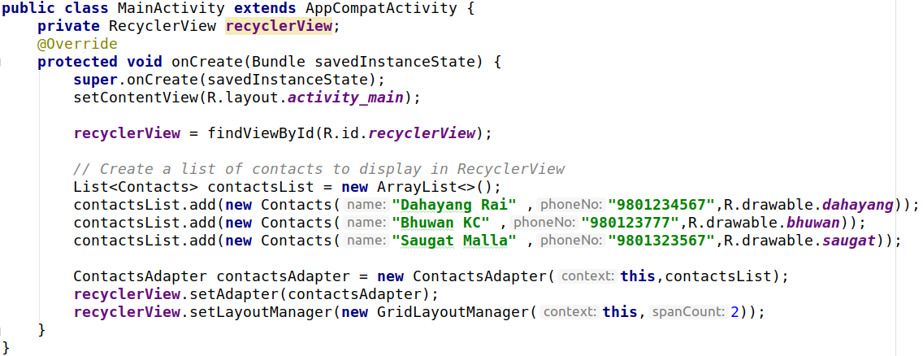
Code

Slide 30
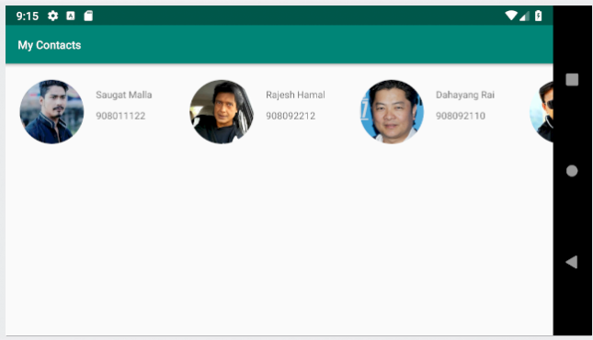
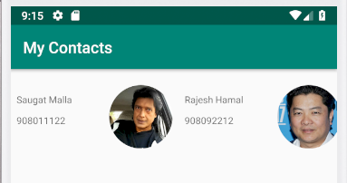
Displaying contacts horizontally

Slide 31
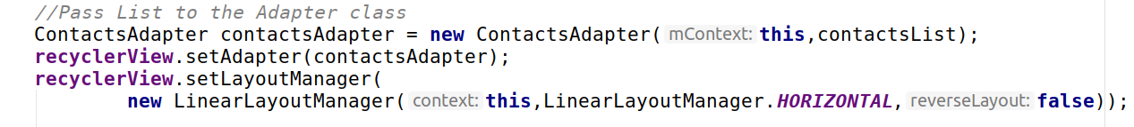
Code
Make Sure you set layout_width:wrap_content in relative layout

Slide 32
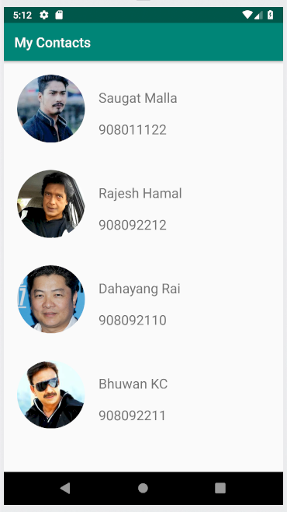
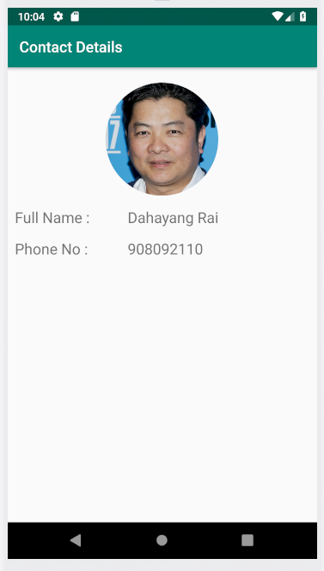
Displaying Contact details in another activity

Slide 33
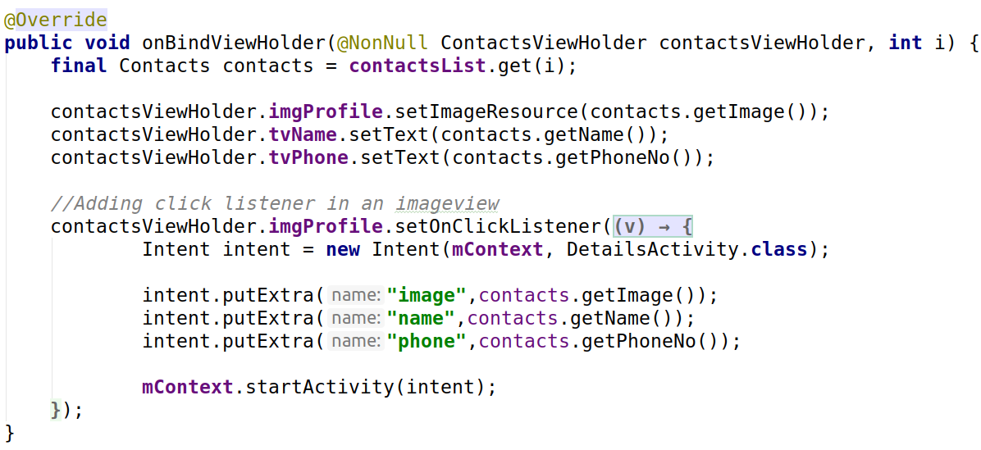
Adding click listener on ImageView in RecyclerView

Slide 34
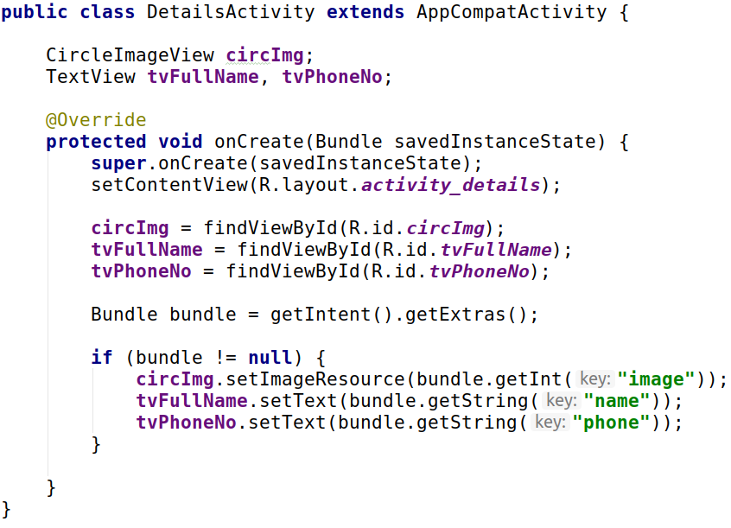
Another Activity

